Slide 1
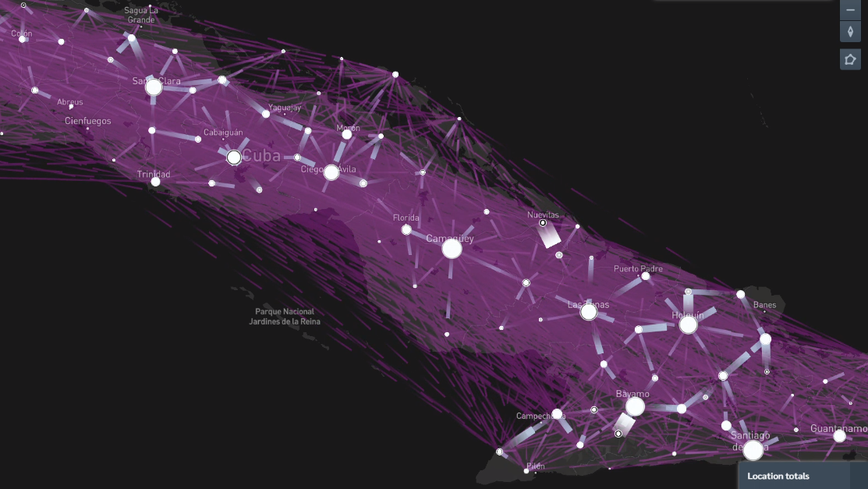

Conf 3.
Introduction to Networks
Dr.
Facultad de Física, UH

Slide 2
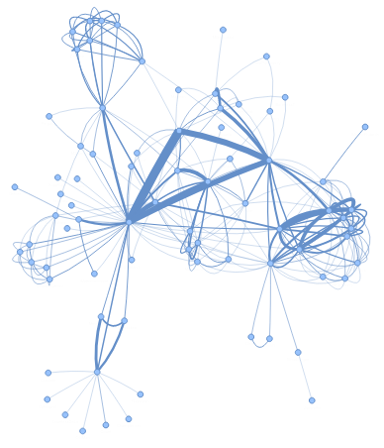

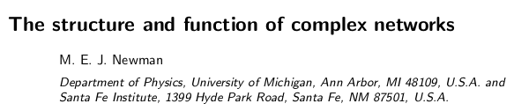


Fast introduction to Networks
Graphs, mathematical deifinition
Which nodes are important?
Local and global properties and parameters
Small famous networks, Large networks
Random graphs
Building your own graphs: Regular, poissonian, SBM
Visualizing graphs

Slide 3
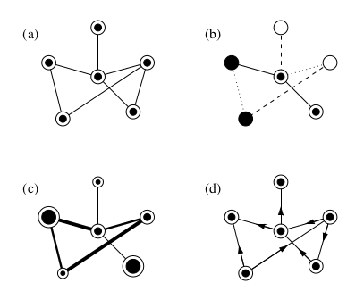
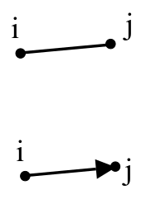
Vertex, edges and Graphs
Vertex = nodes Edges = links
(a) Simple graph
(b) Types of nodes, edges
(c) Weighted vs Weigthed
(d) Directed

Slide 4
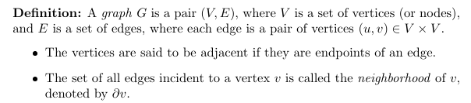
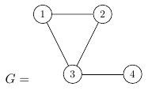
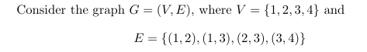
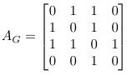
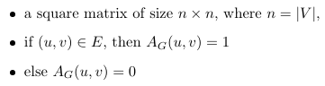
Graphs

Slide 5
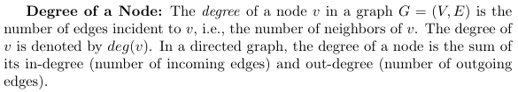
Graphs

Slide 6
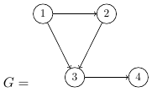
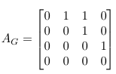
Directed Graphs

Slide 7
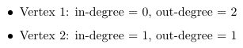
Directed Graphs

Slide 8
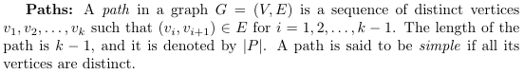
Paths and cycles

Slide 9
Paths and cycles

Slide 10
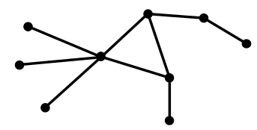
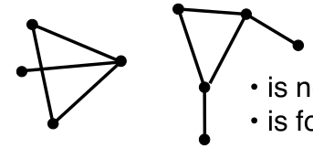
Connected components
Paths between every pair of vertex
Connected components
A giant component: a connected component with an amount of nodes proportional to N.

Slide 11
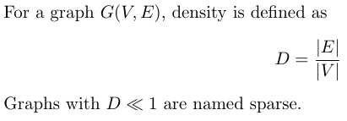
Connected components
Paths between every pair of vertex
Density:

Slide 12
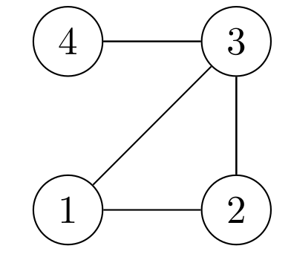
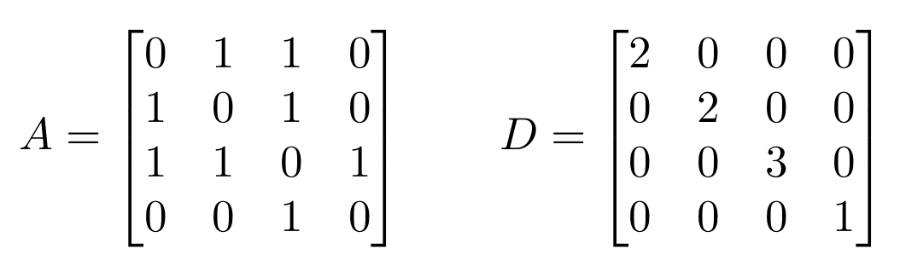
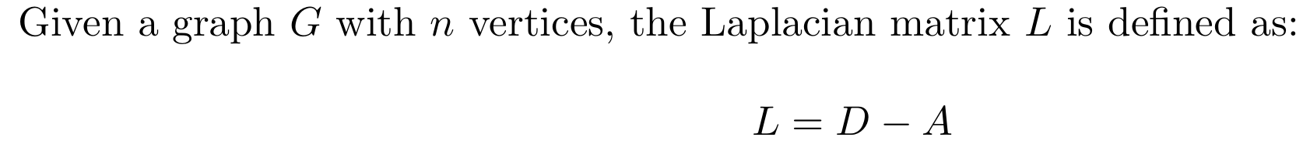
Laplacian Matrix
Paths between every pair of vertex

Slide 13
Shortests path
The set of all paths.
The shortest path: geodesic distance

Slide 14
Shortests path
The set of all paths: breadth first search
The shortest path: geodesic distance
Powers of the Adjacency Matrix.

Slide 15
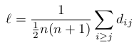
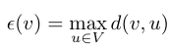
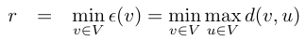
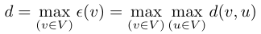
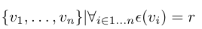
Distance metrics
Mean distance: Average of distances between all pairs of nodes in a Connected Graph
Eccentricity of vertex v: distance to the farthest vertex
Radius of a graph: shortest eccentricity
Diameter of a graph: largest eccentricity
Jordan center: Nodes with minimum eccentricity
Try all in this graph

Slide 16
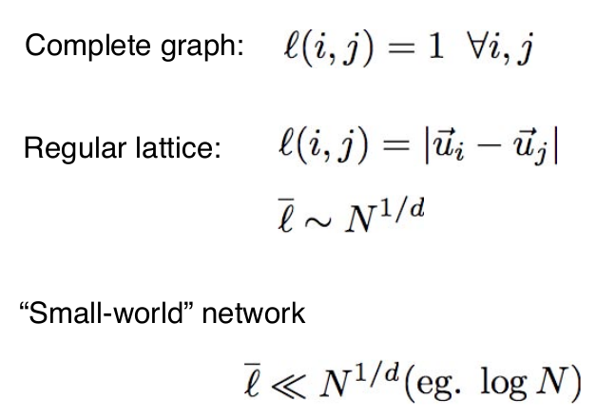
Shortests path

Slide 17
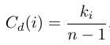
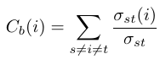
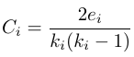
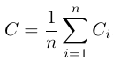
Centrality measures
Degree centrality: fraction of system connected to node i
Betweeness: are you part of many shortest paths
Clustering coefficient: are your neighbors, also my neighbors
Global clustering coefficient:
Try all in this graph

Slide 18
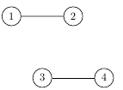
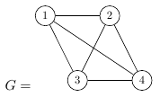
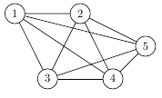
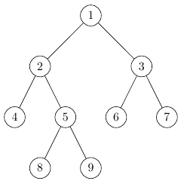
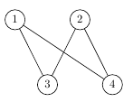
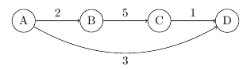
Graphs properties
Directed vs undirected
Connected vs Disconnected
Regular vs Non regular
Planar vs Non planar
Cyclic vs Tree
Bipartite
Weighted

Slide 19
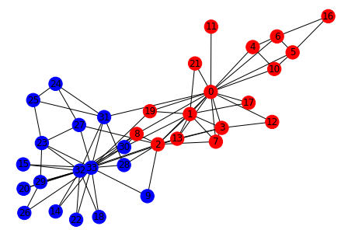
famous networks
Useful for benchmarking
Field specific
Zachary’s Karate Club
Studied by Zachary, in a paper in 1977
34 nodes, people in a Club
78 edges, ¨friendship¨
Used for community detection
Characteristics
Undirected
Connected

Slide 20
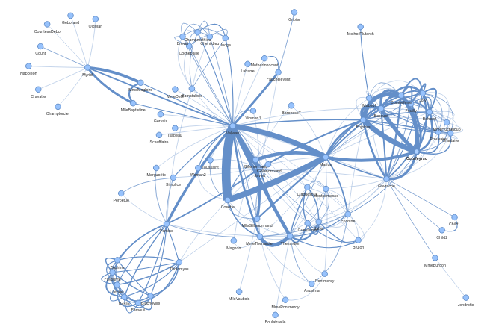
famous networks
Useful for benchmarking
Field specific
Les Miserables (Novel by Victor Hugo)
77 nodes, characters in the novel
254 edges, present in the same chapter
Used for community detection
Characteristics
Undirected
Connected
Wheigted

Slide 21
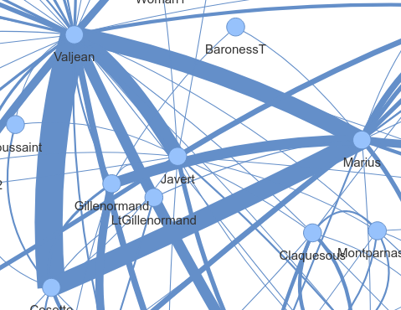
famous networks
Useful for benchmarking
Field specific
Les Miserables (Novel by Victor Hugo)
77 nodes, characters in the novel
254 edges, present in the same chapter
Used for community detection

Slide 22
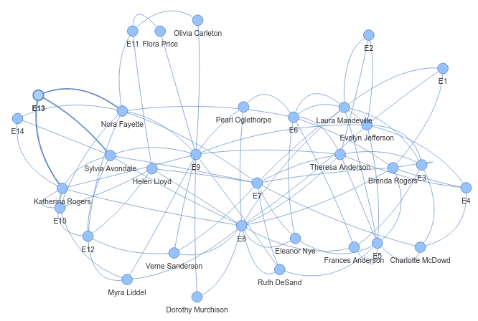
famous networks
Useful for benchmarking
Filed specific
Davis Southern Women Graph
Studied by A. Davis, in a paper in 1941
32 nodes, women in a Social Club
89 edges, social events together
Characteristics
Undirected
Connected
Weighted
A. Davis, Gardner, B. B., Gardner, M. R., 1941. Deep South. University of Chicago Press, Chicago, IL.

Slide 23
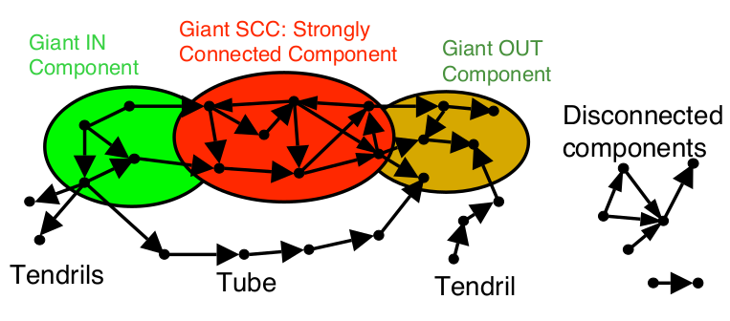
famous networks
Useful for benchmarking
Filed specific
Internet Graph
Broder et al, 2000
Characteristics
Directed
Disconnected

Slide 24
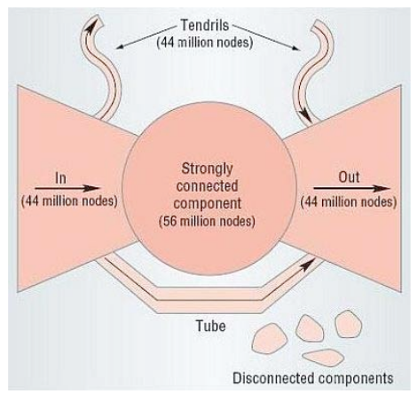
famous networks
Useful for benchmarking
Filed specific
Internet Graph
Broder et al, 2000
Characteristics
Directed
Disconnected

Slide 25
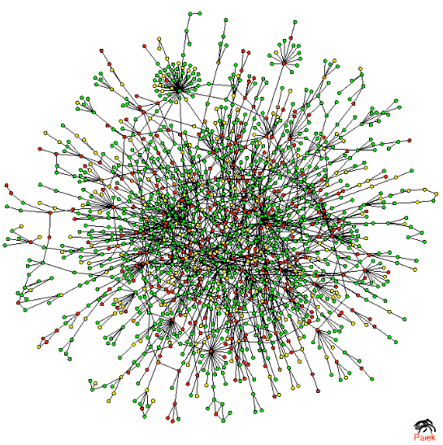
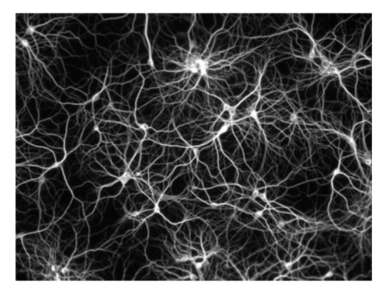
famous networks
In biology
Trophic chain
Protein-protein interaction network
Gene regulatory network
Metabolic networks
Brain connectivity
Human circulatory network
Phylogenetic trees

Slide 26
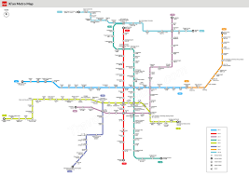
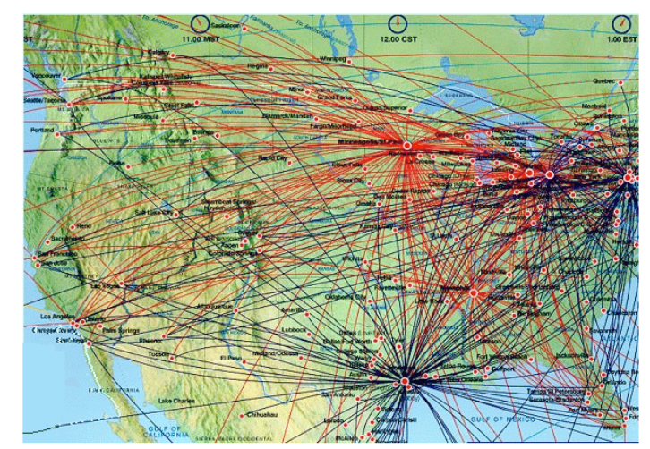
famous networks
Technological networks
Electric grid
Water distribution system
City Transport networks
Airtravel networks

Slide 27
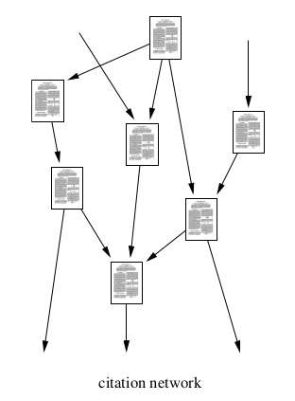
famous networks
Social Networks
Citation network
Scientific collaboration network
Twitter, instagram, facebook
Sex couples
Road networks
Human mobility network
Air trafic network
Genealogic trees

Slide 28
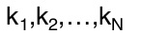
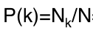
Statistical description
Full description G(V,E). When are two graphs equal?
Degree list: extensive in N.
Degree histogram: number of nodes with a certain degree k.
Degree distribution:
Graph ensembles

Slide 29

Statistical description
Full description G(V,E). When are two graphs equal?
Degree list: extensive in N.
Degree histogram: number of nodes with a certain degree k.
Degree distribution:
Graph ensembles
Regular graph

Slide 30



Statistical description
Average degree: Variance:
Heterogeneous graph
Regular graph

Slide 31
Random graphs
Random means:
An algorithm to create graphs
That is non-deterministic.
The algorithm define a probability over the set of all possibles graphs.

Slide 32


Random Regular graphs
Random means:
An algorithm to create graphs
That is non-deterministic.
The algorithm define a probability over the set of all possibles graphs.
Example.
Random regular graph RRG(n=4,d=2), RRG(n=4,d=1)

Slide 33

Random Uncorrelated graphs
Random means:
An algorithm to create graphs
That is non-deterministic.
The algorithm define a probability over the set of all possibles graphs.
Remaining degree distribution:
Uncorrelated networks:
A graph where the remaining degree distribution of a node is independent of the degree of its neighbors
Example. Random Poissonian graph with mean connectivity

Slide 34


Practical Class
Implement this graph in Networkx:
Check documentation in:
https://networkx.org/
https://networkx.org/documentation/stable/tutorial.html
https://networkx.org/documentation/stable/reference/functions.html
Change nodes names to correpond to the drunken man problem:
Extract the adjacency matrix.
For each node, compute: eccentricity, clustering coefficient, betweenness.
Find the Jordan Center of this graph
Check that adjacency matrix powers can be used to compute the number of pahts between nodes.

Slide 35
Homework
Study the properties of the Les Miserables graph
Is this graph connected? Weighted? A tree?
Fin degree distribution
For each node, compute: centrality, clustering coefficient, betweenness.
Which characters have the highest betweenness? Clustering?
Which chacracters are the center (Jordan Center ) of this graph?
Plot the assortativity of this graph

Slide 36




你好
Facultad de Física
Universidad de La Habana

